Slide 1
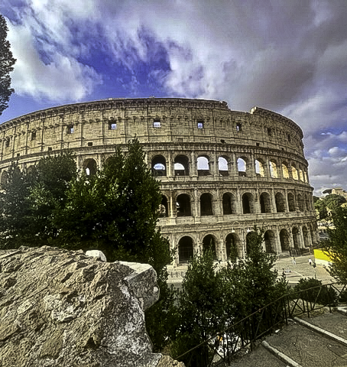


LET’S GO TO
Italy!

Slide 2


SCAN QR CODE
Scan here to follow along during the presentation
Insert Custom
Registration Page
QR Code

Slide 3

Why are you excited to go to Italy?
Students
1
2
3
4
5
To gain real-life exposure of Latin language & culture
My friend is going
To live with a host family
To see the sights & eat the food
To escape laundry & dishes duty for a while

Slide 4
Why are you excited for your child to go to Italy?
Parents &
Guardians
1
2
3
4
5
To gain real-life exposure of Latin language & culture
To learn about another culture
To become more independent
For college & career readiness
To find out if they can survive without WiFi & constant texting

Slide 5
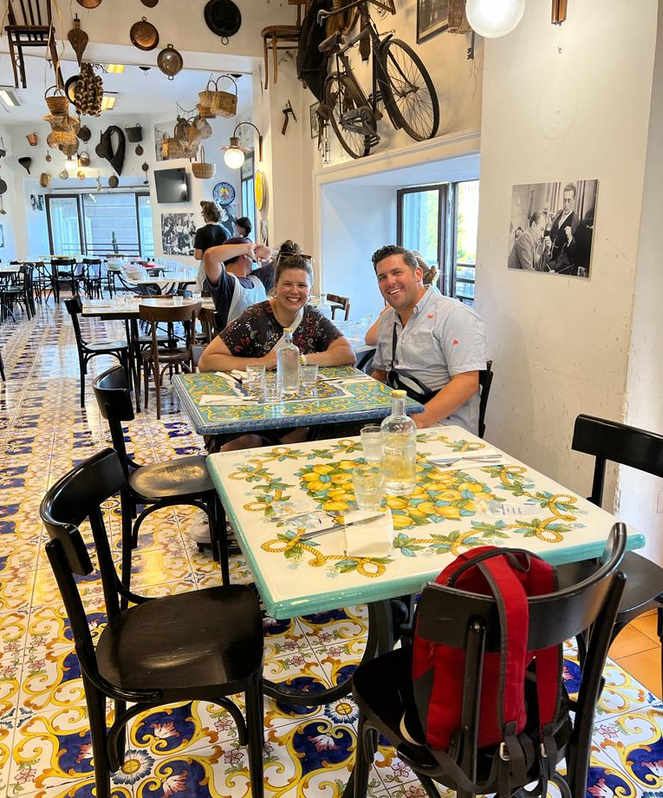
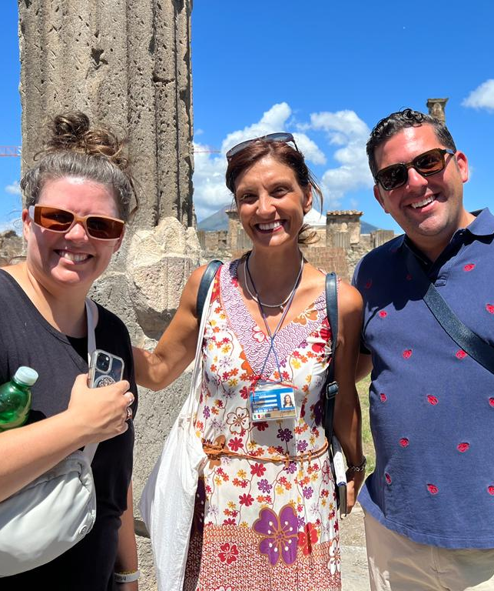
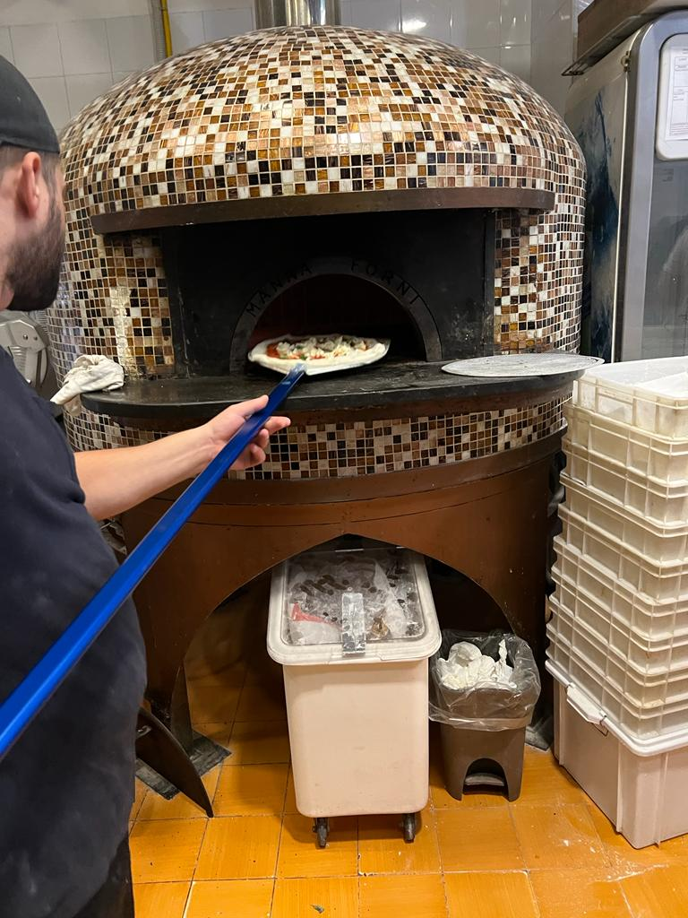



NONPROFIT
50+ YEARS OF EXPERIENCE
COLLABORATION WITH EDUCATORS & FIELD EXPERTS

Slide 6


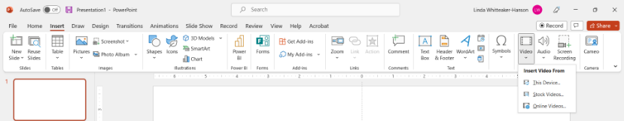




Insert Xperitas One Minute Video
Video can be accessed via the clickable link above. Due to restrictions regarding video cloud applications like YouTube and Vimeo, you will have to download this to your local device and insert it into the presentation.

Slide 7










SEEING THE SITES

Slide 8






TRYING NEW FOODS

Slide 9
Insert Latin Program Sneak Peek video
Video can be accessed via the clickable link above. Due to restrictions regarding video cloud applications like YouTube and Vimeo, you will have to download this to your local device and insert it into the presentation.

Slide 10
"Having our child experience another culture and have his eyes opened to the world outside of his hometown was life-changing. Watching him gain confidence through this experience where he needed to challenge himself and be independent was a joy."
- Parent of a German Immersion student
"His increase in love for the Spanish language as well as foreign cultures. This trip fueled his desire to travel and experience more of our world."
- Parent of a Spanish Immersion student to Costa Rica

Slide 11

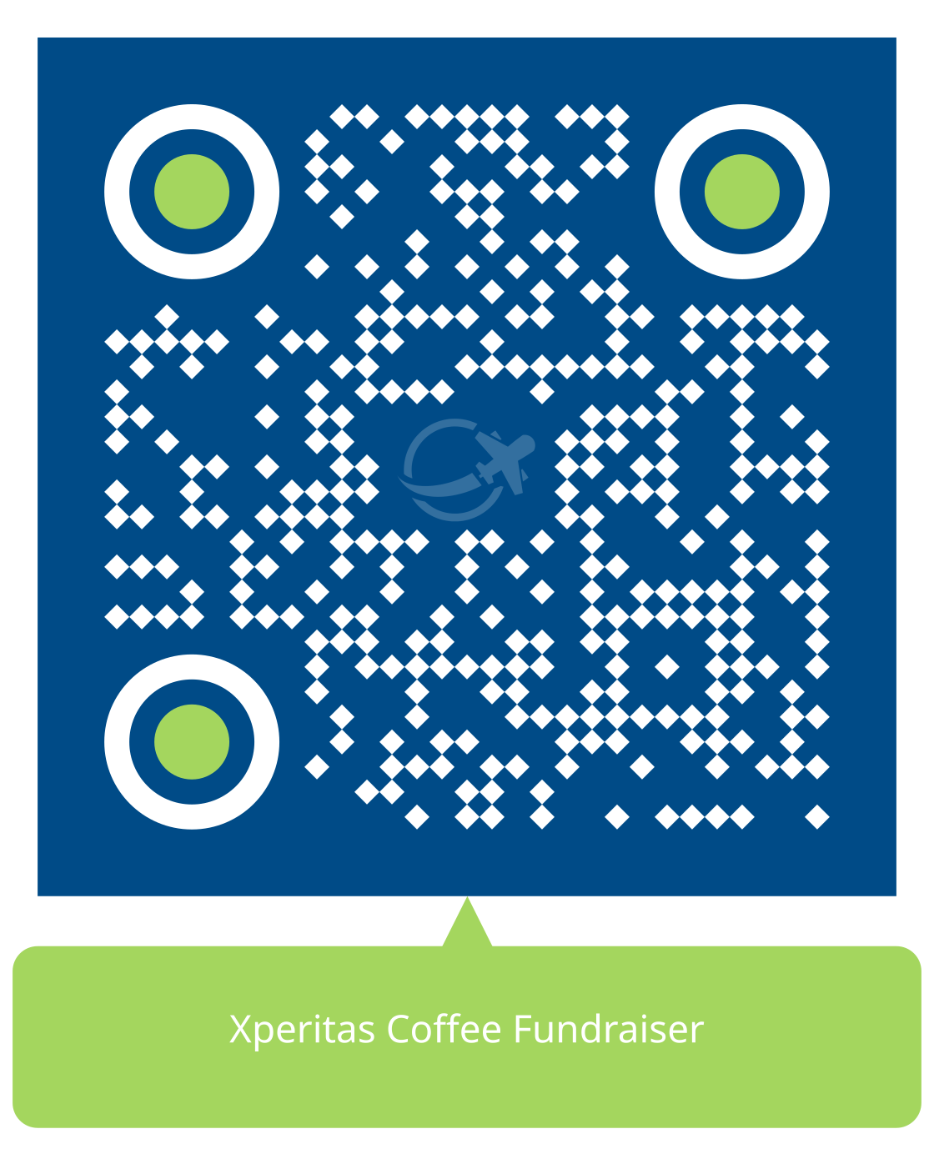
Finances
Financial Aid
Fundraising Ideas
Household income of $60,000 or less
Provides up to 60% of program price
Deadline: October 15
My Contribution Page
Hosting fundraising events
Xperitas Coffee Fundraiser (QR code below)
Other Opportunities
Early Bird Discount: Enroll before June 15 to receive a $200 discount.
Photo Contest(s)
Writing Contest
Notes:
Depends on the language (Spanish/German)

Slide 12
Program
Pricing
$XXXX per student,
Plus cost of international flights*
*(Insert departure city + estimated air cost provided by PM)
Round-Trip Airfare
Accommodations per itinerary
Meals & Activities Per Itinerary
In-Country Transportation Per Itinerary
*Travelers should not arrange their own air. AIR is included in the program, but the cost will be added once the air contract is confirmed.
Family Stay Experience®
24/7 Support
While abroad
Medical Insurance
View our Rest Assured Advantages

Slide 13
Payment Schedules
JUNE 15
OCTOBER 1
NOVEMBER 1
DECEMBER 1
JANUARY 15
Early Bird
$500 Deposit
Final Enrollment*
Deadline ($500)
$1,000
$1,000
Remaining balance
Spring
*No payment due for Early Bird Registrants
JUNE 15
OCTOBER 15
NOVEMBER 15
JANUARY 15
MARCH 15
Early Bird
$500 Deposit
Final Enrollment*
Deadline ($500)
$1,250
$1,250
Remaining balance
Summer
*No payment due for Early Bird Registrants
Notes:
Early Bird discount page – delete if the parent meeting is happening after this date

Slide 14
Payment Schedules
OCTOBER 1
NOVEMBER 1
DECEMBER 1
JANUARY 15
Final Enrollment
Deadline ($500)
$1,000
$1,000
Remaining balance
Spring
OCTOBER 15
NOVEMBER 15
JANUARY 15
MARCH 15
Final Enrollment
Deadline ($500)
$1,250
$1,250
Remaining balance
Summer
Notes:
WITHOUT early bird special

Slide 15
Cancellation Schedules
OCTOBER 2
NOVEMBER 15
30 DAYS PRIOR
Nonrefundable $100
Upon Enrollment
$250 Admin Fee
$500 admin fee PLUS incurred expenses
No refund
Spring
OCTOBER 16
DECEMBER 1
30 DAYS PRIOR
Nonrefundable $100
Upon Enrollment
$250 Admin Fee
$500 admin fee PLUS incurred expenses
Summer
No refund

Slide 16


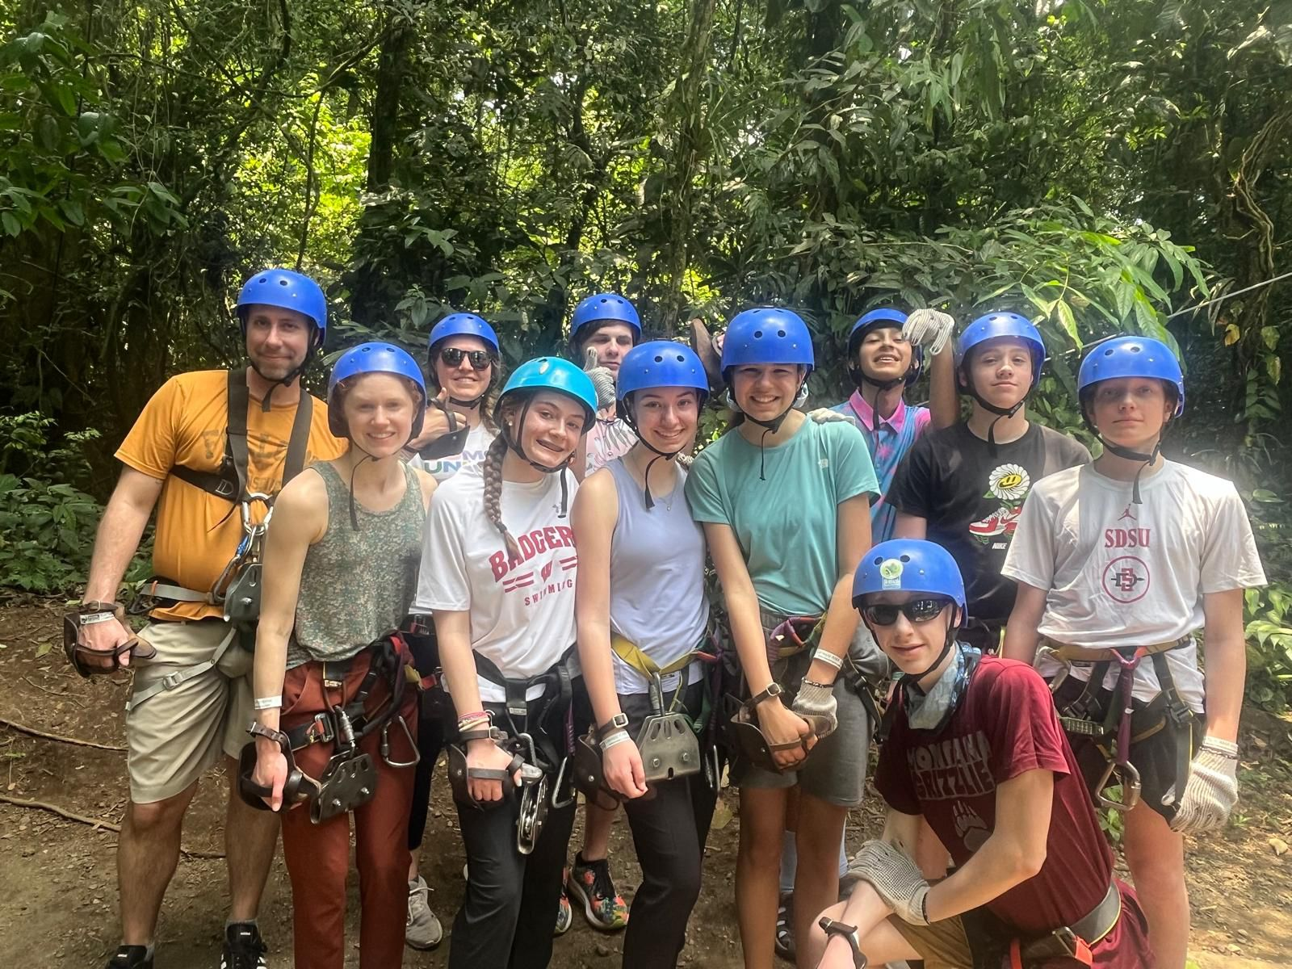



Insurance
Trip cancellation coverage (for medical reasons) and medical insurance coverage is included. Discover more about our comprehensive support at https://xperitas.org/resources/medical-insurance.
Health
& Safety
Support
Your Program Manager is your #1 support and point of contact, in addition to a 24-Hour Xperitas phone number during travel.
STEP
Smart Traveler Enrollment Program
Travelers must enroll in STEP, 1-3 weeks before program departure. Xperitas will send a guide for how to enroll:
https://mytravel.state.gov/s/step
Notes:
STEP: remove section from Puerto Rico (domestic location)

Slide 17


How to
Enroll & Find Additional Information
Insert Custom
Registration Page
QR Code
Notes:
LEADERS:
Please insert your Custom Registration
Page QR code your Program Manager emailed you

Slide 18


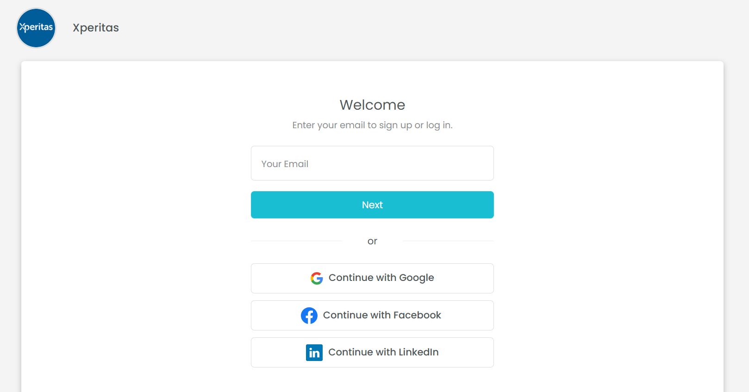
ENROLL AND PAY DEPOSIT
Next Steps
Click on “Enroll now” and complete registration form. Pay the $500 deposit.
ACCESS YOUR PORTAL
Click the “Manage Booking” link in your confirmation email to access the portal. No password is required.
COMPLETE FORMS
Fill out the forms in the portal, particularly the
Health Information and Student Code of Conduct.
NEWSLETTERS
Pay attention to the newsletters that contain important reminders and deadlines! If you unsubscribe from any Xperitas emails, we cannot add you back.
GET PASSPORT
Processing times may be long. Passports should be valid at least 6 months past program return date.

Slide 19

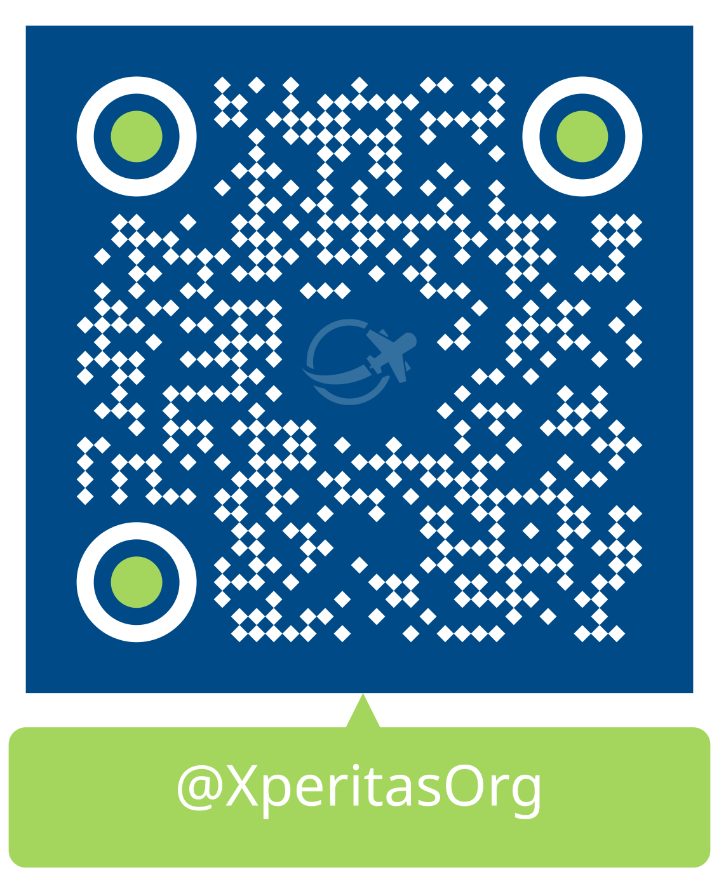

How To Contact Us
Enrollment, Payment, Portal Login
Follow Us On Instagram
Registration@Xperitas.org
Program Details
Matthew@Xperitas.org
Financial Aid and Scholarships
Leslie@Xperitas.org
www.Xperitas.org

