Slide 1



LET’S GO TO
Puerto Rico!

Slide 2


SCAN QR CODE
Scan here to follow along during the presentation
Insert Custom
Registration

Slide 3









5 Reasons You Definitely Should Not Go to Puerto Rico
1. Your Spanish Will Get Too Good!
Imagine returning home and suddenly understanding all those Spanish songs and TV shows. You’ll sadly have no excuses for not doing your Spanish homework anymore!
2. You'll Get Addicted to Fresh Fruits!
Seriously, who wants to eat pineapples and coconuts fresh from the source? You might develop an unhealthy obsession with tropical fruit and smoothies.
3. You'll Become a Coffee Snob!
After tasting the rich, flavorful Puerto Rican coffee, you'll never be able to look at your regular cup of joe the same way again. Starbucks? Please.
4. The Nature is Just Too Perfect!
Lush green rainforests, stunning coastline, and pristine beaches every day? You'll never want to leave, and then what will you do with all your winter clothes?
5. You'll Have Too Many Adventures!
From setting sail on a catamaran to kayaking through a bioluminescent bay, you’ll actively explore Puerto Rico. Who needs all that adrenaline, right?
Notes:
Now that you’ve seen the schedule, we have to go over a very important disclaimer, a warning, you definitely should not go to Puerto Rico for the following reasons, please consider them carefully (then slowly reveal 1 -5)

Slide 4
5 Reasons You Definitely Should Not Go to Puerto Rico...
Students
Your Spanish Will Get Too Good!
Imagine returning home and suddenly understanding all those Spanish songs and TV shows. You’ll sadly have no excuses for not doing your Spanish homework anymore!
You'll Get Addicted to Fresh Fruits!
Seriously, who wants to eat pineapples and coconuts fresh from the source? You might develop an unhealthy obsession with tropical fruit and smoothies.
You'll Become a Coffee Snob!
After tasting the rich, flavorful Puerto Rican coffee, you'll never be able to look at your regular cup of joe the same way again. Starbucks? Please.
The Nature is Just Too Perfect!
Lush green rainforests, stunning coastline, and pristine beaches every day? You'll never want to leave, and then what will you do with all your winter clothes?
You'll Have Too Many Adventures!
From setting sail on a catamaran to kayaking through a bioluminescent bay, you’ll actively explore Puerto Rico. Who needs all that adrenaline, right?

Slide 5

Why are you excited to go to Puerto Rico?
Students
1
2
3
4
5
To improve my Spanish
My friend is going
To live with a host family
To see the sights & eat the food
To escape laundry & dishes duty for a while

Slide 6
Why are you excited for your child to go to Puerto Rico?
Parents &
Guardians
1
2
3
4
5
To improve their Spanish
To learn about another culture
To become more independent
For college & career readiness
To find out if they can survive without WiFi & constant texting

Slide 7

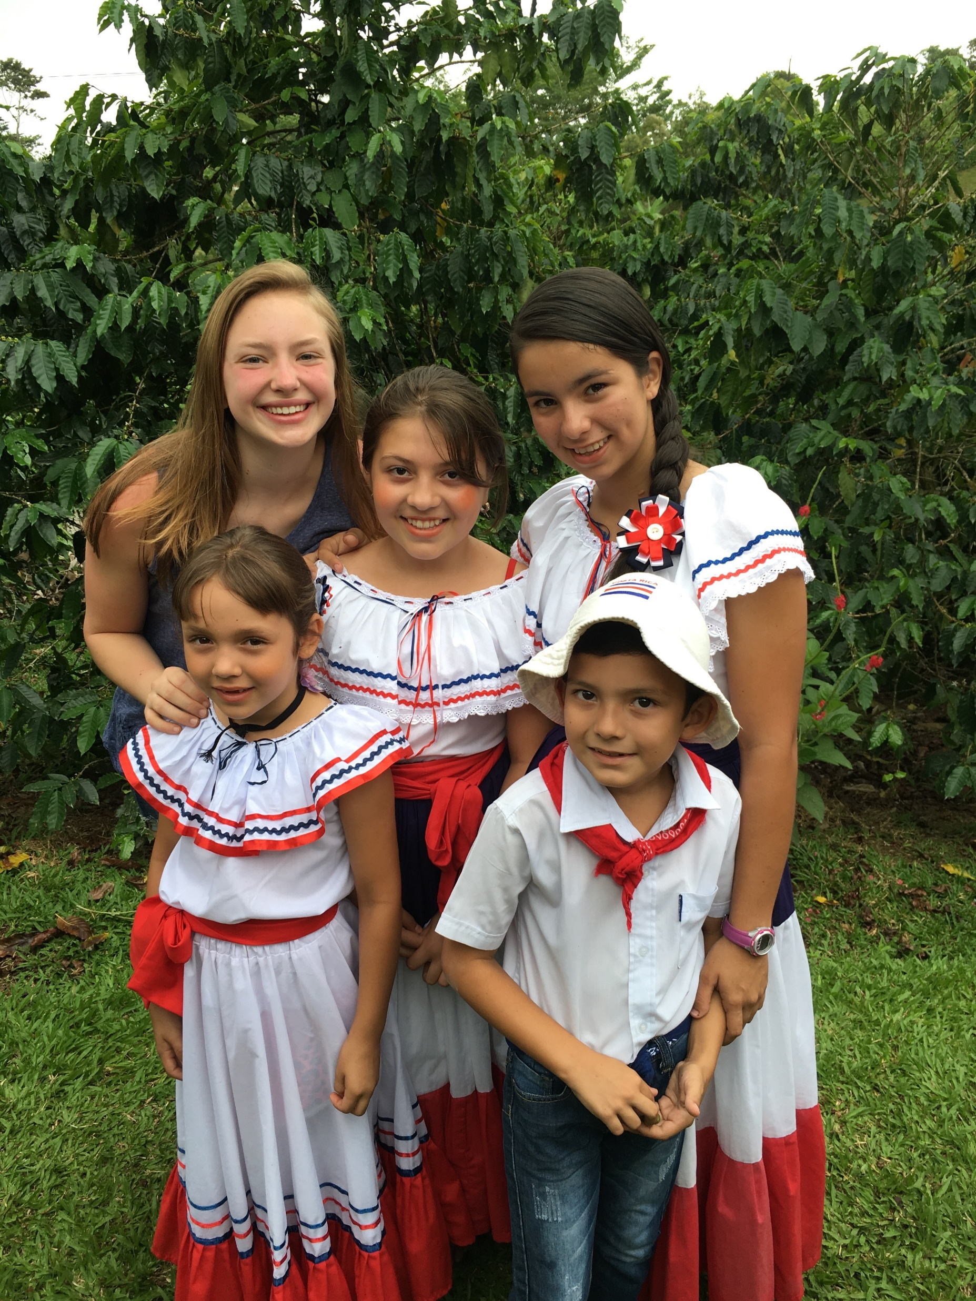




NONPROFIT
50+ YEARS OF EXPERIENCE
FAMILY STAY EXPERIENCE®

Slide 8
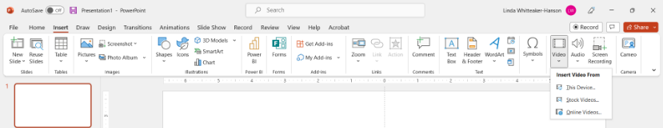




Insert Xperitas One Minute Video
Video can be accessed via the clickable link above. Due to restrictions regarding video cloud applications like YouTube and Vimeo, you will have to download this to your local device and insert it into the presentation.

Slide 9

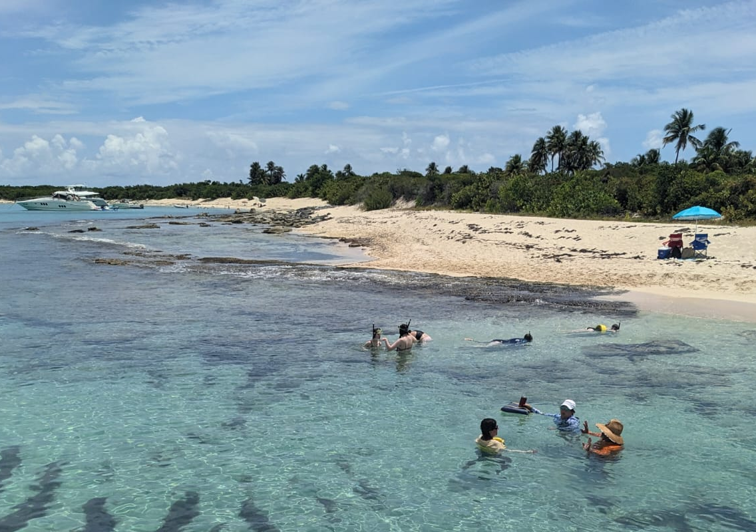

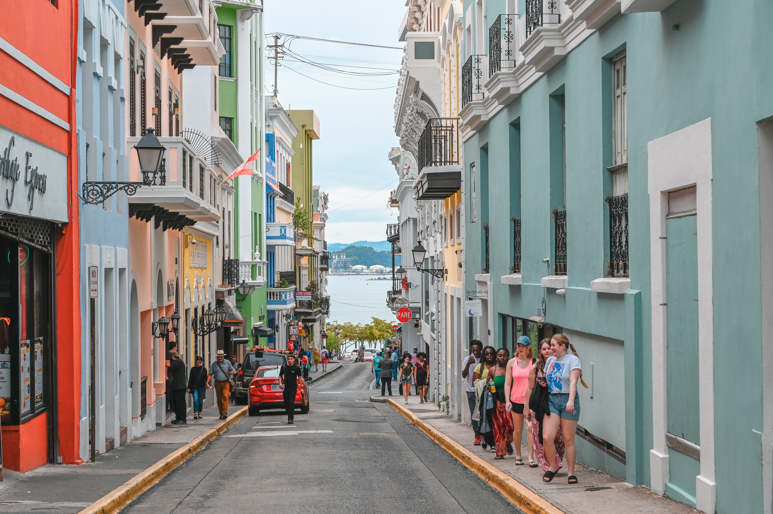
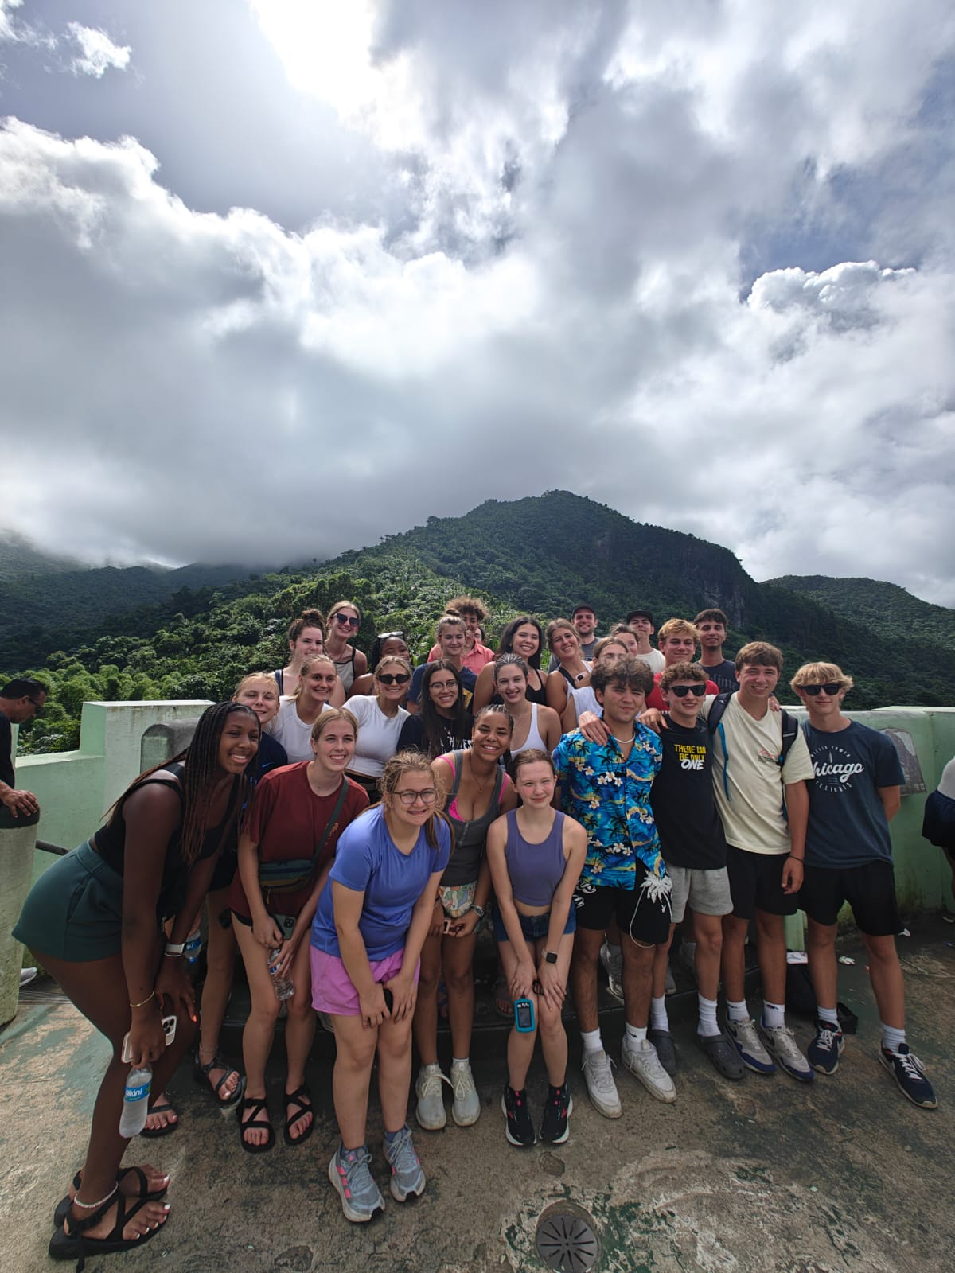
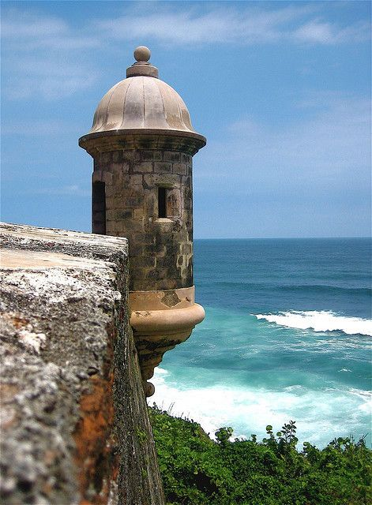



SEEING THE SITES
Notes:
Top Row (L-R):
Beach near Luquillo where you’ll set sail on a catamaran and snorkel
Walk around Viejo San Juan and appreciate the bright colors and colonial architecture influenced by Spanish colonization
A farmers' market in the Rio Piedras neighborhood of San Juan-there you’ll practice your Spanish with a scavenger hunt
Bottom Row (L-R):
El Yunque National Forest offers beautiful views of nearby mountains, as well as close-up views of the flora and fauna. El Yunque is the only tropical rainforest in the U.S. National Forest system.
Students will get to kayak at one of the three bioluminescent bays located in Puerto Rico!
Admire the murals that line San Juan’s streets and buildings

Slide 10
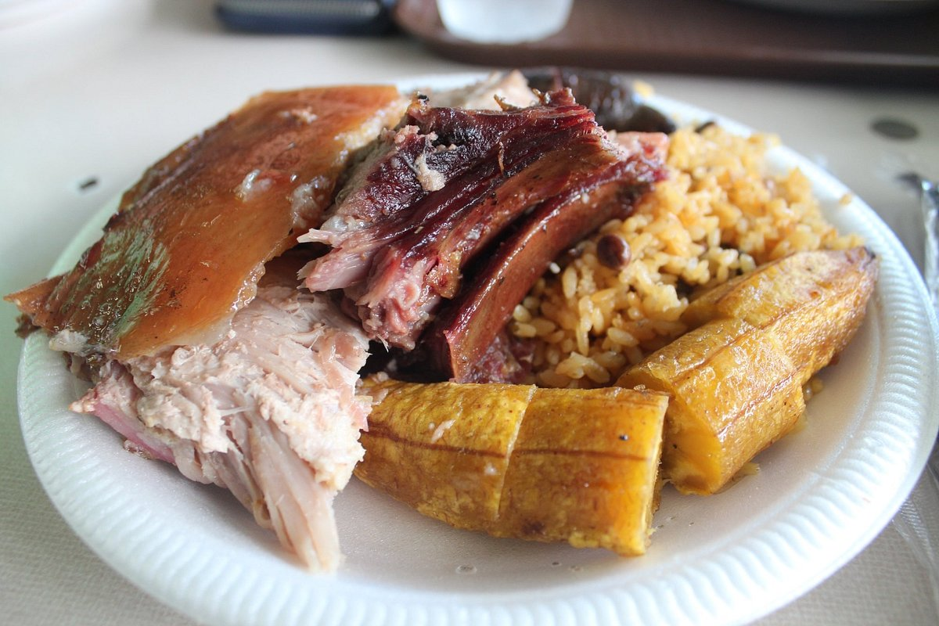

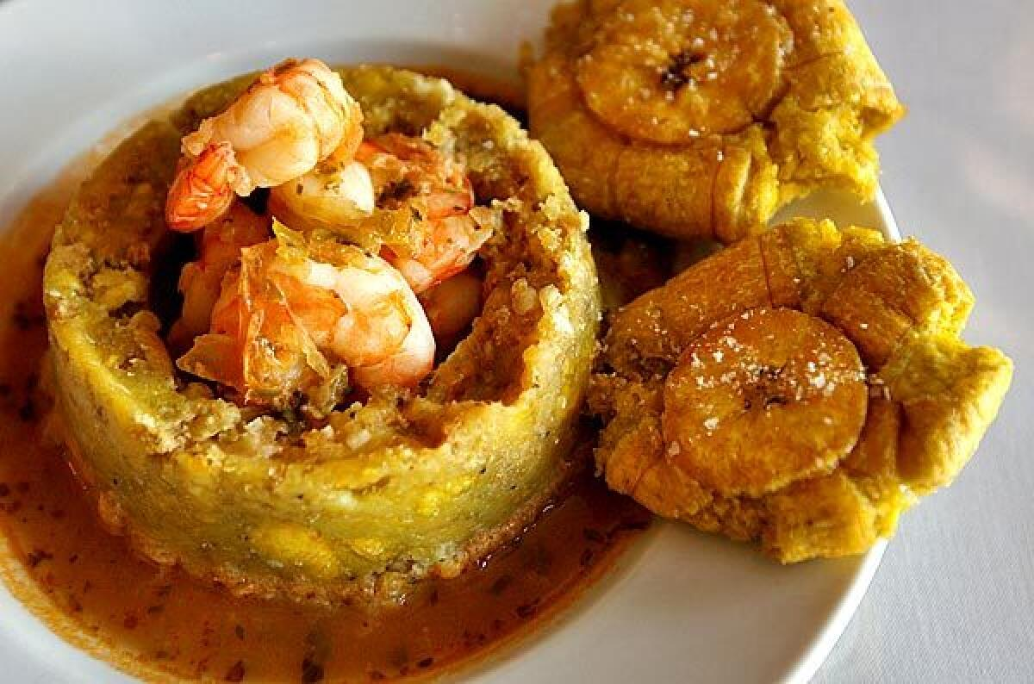


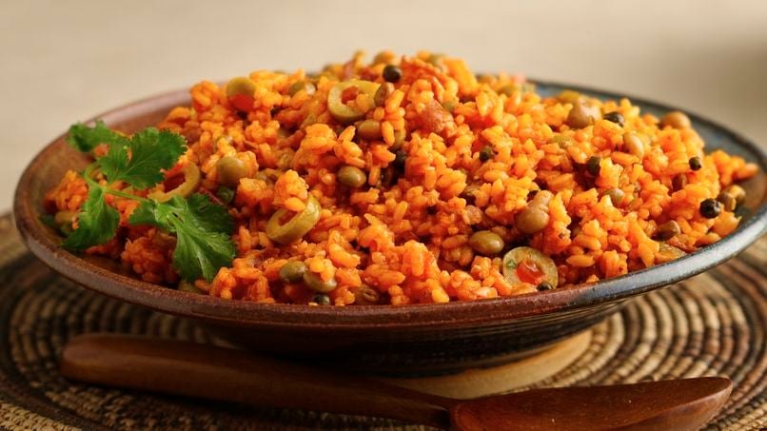
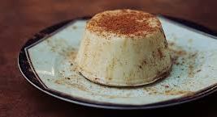
TRYING NEW FOODS
Notes:
Top row (L-R):
Lechon asado with rice and sweet plantains
Asopao refers to a savory soup that has meat, rice, and pigeon peas (gandules)
Mofongo is a seasoned mountain of mashed plantains that is filled with your choice of meat and topped off with a broth-there are tostones, twice-fried plantains, to the left of the mofongo mountain.
Bottom row (L-R):
Café con leche with the breakfast pastry known as quesito
Tembleque is a coconut pudding similar to flan
Arroz con gandules is an iconic meal that features rice seasoned with sofrito, beans, and pigeon peas (gandules)

Slide 11


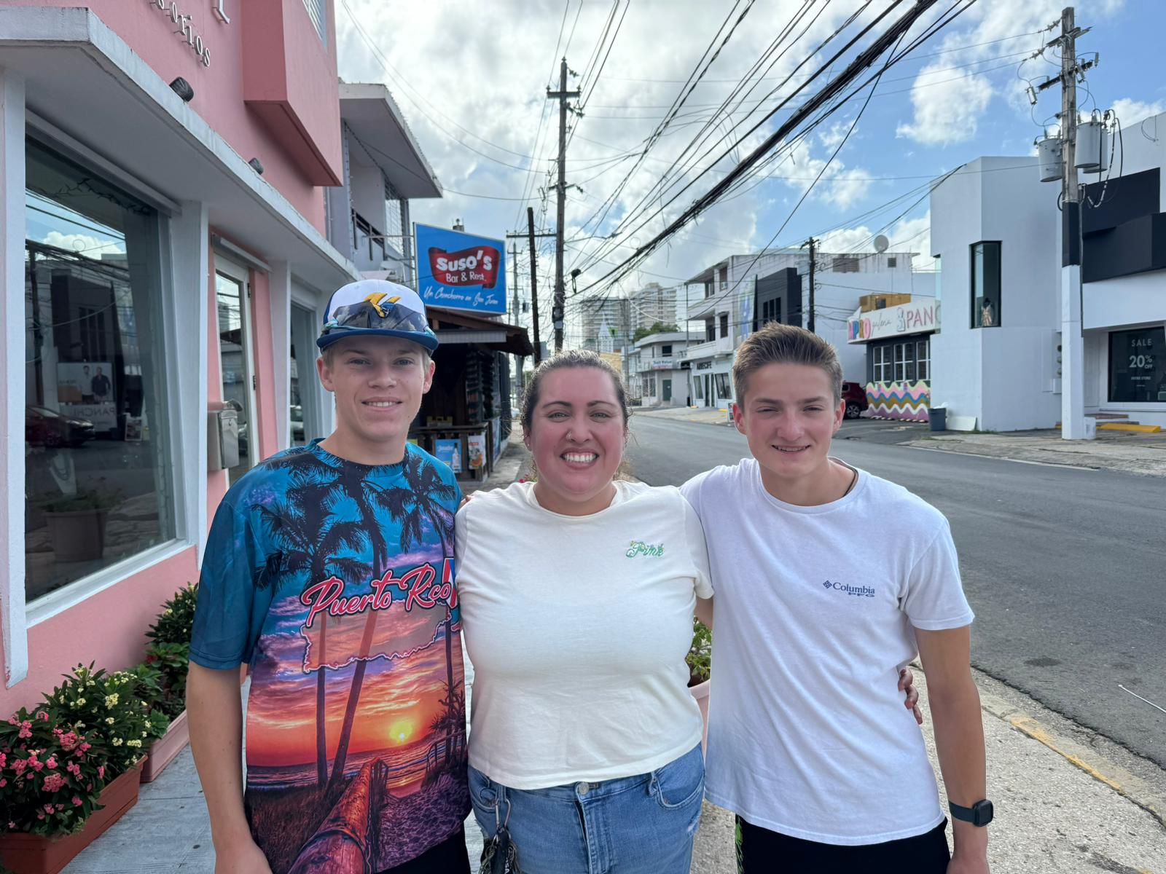
Family Stay
Experience®
50+ years of expertise
Trusted family stay coordinators
9 of 10 students say it is the best part of the program

Slide 12
Insert Puerto Rico Video
Video can be accessed via the clickable link above. Due to restrictions regarding video cloud applications like YouTube and Vimeo, you will have to download this to your local device and insert it into the presentation.

Slide 13
"Having our child experience another culture and have his eyes opened to the world outside of his hometown was life-changing. Watching him gain confidence through this experience where he needed to challenge himself and be independent was a joy."
- Parent of a German Immersion student
"His increase in love for the Spanish language as well as foreign cultures. This trip fueled his desire to travel and experience more of our world."
- Parent of a Spanish Immersion student to Costa Rica

Slide 14
Finances
Financial Aid
Fundraising Ideas
Household income of $60,000 or less
Provides up to 60% of program price
Deadline: October 15
Xperitas Coffee Fundraiser
My Travel Fund
Hosting fundraising events
Other Opportunities
Early Bird Discount: Enroll before June 15 to receive a $200 discount.
Photo Contest(s)
Writing Scholarship
National Spanish Exam Discount
Notes:
Depends on the language (Spanish/German)

Slide 15
Program
Pricing
$xxx
XX Days
What's included in our price?
Trip Cancellation
Medical Insurance
Financial
Assistance
Pre-Travel Support
Support While Traveling
Misc. Travel costs
Medical Reasons
Ex: Hotel, Trains, Family Stay...
View our Rest Assured Advantages

Slide 16
Payment Schedules
JUNE 15
OCTOBER 1
NOVEMBER 1
DECEMBER 1
JANUARY 15
Early Bird
$500 Deposit
Final Enrollment*
Deadline ($500)
$1,000
$1,000
Remaining balance
Spring
*No payment due for Early Bird Registrants
JUNE 15
OCTOBER 15
NOVEMBER 15
JANUARY 15
MARCH 15
Early Bird
$500 Deposit
Final Enrollment*
Deadline ($500)
$1,250
$1,250
Remaining balance
Summer
*No payment due for Early Bird Registrants
Notes:
Early Bird discount page – delete if the parent meeting is happening after this date

Slide 17
Payment Schedules
OCTOBER 1
NOVEMBER 1
DECEMBER 1
JANUARY 15
Final Enrollment
Deadline ($500)
$1,000
$1,000
Remaining balance
Spring
OCTOBER 15
NOVEMBER 15
JANUARY 15
MARCH 15
Final Enrollment
Deadline ($500)
$1,250
$1,250
Remaining balance
Summer
Notes:
WITHOUT early bird special

Slide 18
Payment Schedules
JUNIO 15
OCTUBRE1
NOVIEMBRE1
DICIEMBRE 1
ENERO 15
Early Bird
$500 Deposit
Final Enrollment*
Deadline ($500)
$1,000
$1,000
Remaining balance
Primavera
*No payment due for Early Bird Registrants
JUNIO 15
OCTUBRE 15
NOVIEMBRE 15
ENERO 15
MARZO 15
Early Bird
$500 Deposit
Final Enrollment*
Deadline ($500)
$1,250
$1,250
Remaining balance
Verano
*No payment due for Early Bird Registrants

Slide 19
Cancellation Schedules
OCTOBER 2
NOVEMBER 15
30 DAYS PRIOR
Nonrefundable $100
Upon Enrollment
$250 Admin Fee
$500 admin fee PLUS incurred expenses
No refund
Spring
OCTOBER 16
DECEMBER 1
30 DAYS PRIOR
Nonrefundable $100
Upon Enrollment
$250 Admin Fee
$500 admin fee PLUS incurred expenses
Summer
No refund

Slide 20


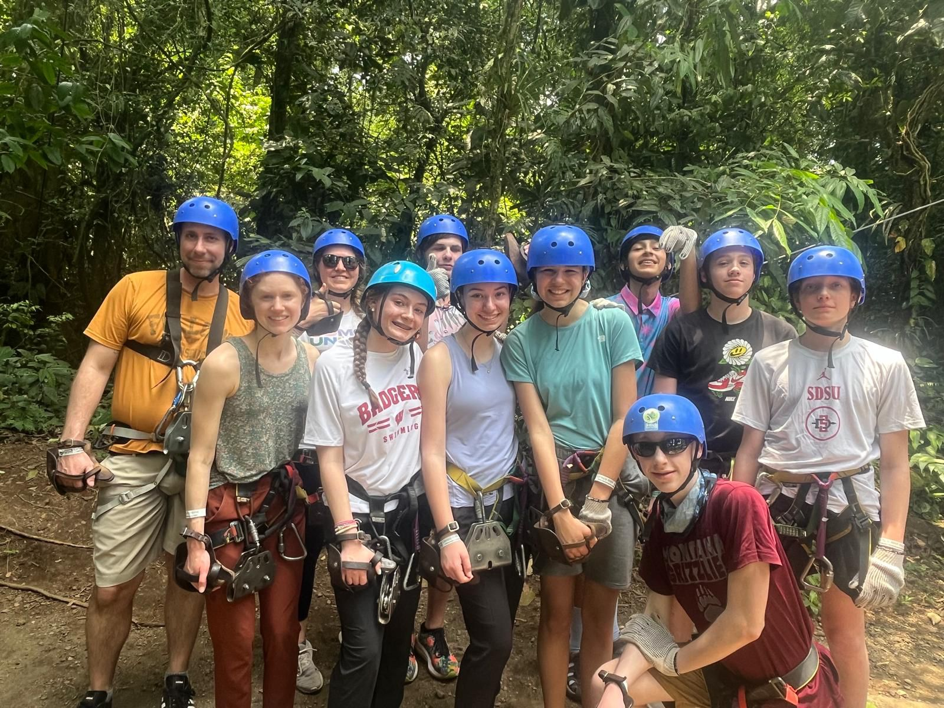


Insurance
Trip cancellation coverage (for medical reasons) and medical insurance coverage is included. Discover more about our comprehensive support at https://xperitas.org/resources/medical-insurance.
Health
& Safety
Support
Your Program Manager is your #1 support and point of contact, in addition to a 24-Hour Xperitas phone number during travel.
Notes:
STEP: remove section from Puerto Rico (domestic location)

Slide 21



How to
Enroll & Find Additional Information
Insert Custom
Registration Page
QR Code
Notes:
LEADERS:
Please insert your Custom Registration
Page QR code your Program Manager emailed you

Slide 22

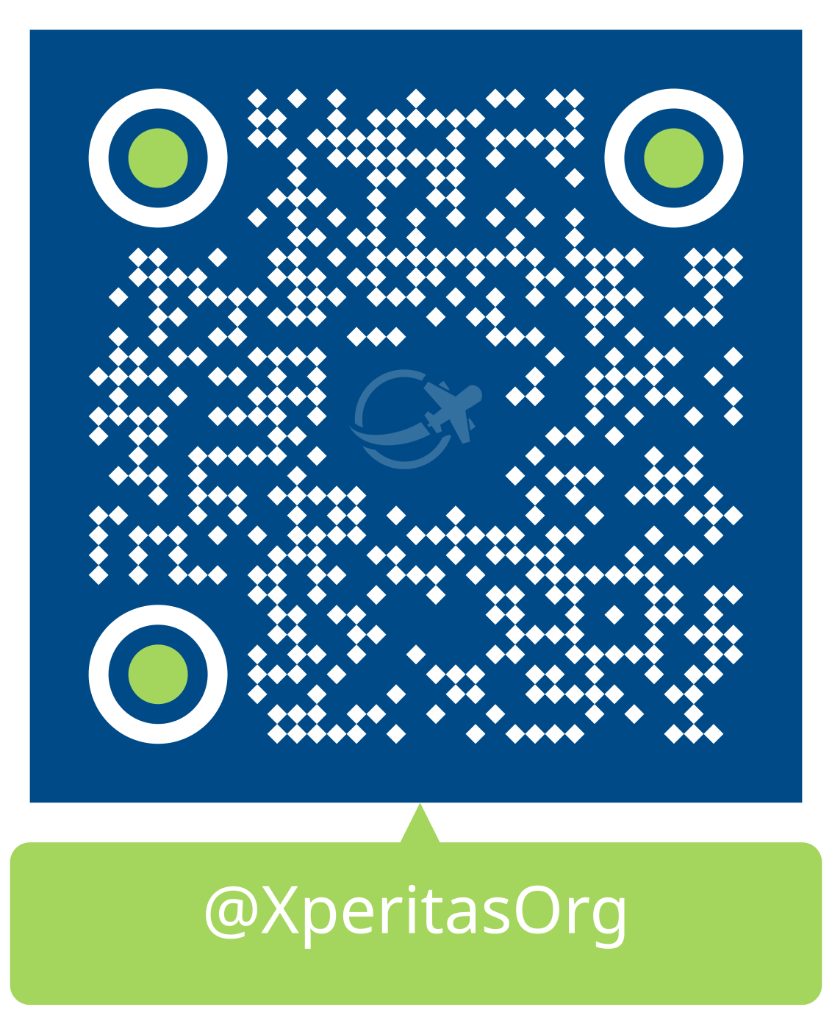
Enrollment Information
Make Sure to Join the
Puerto Rico Immersion Program Because:
Experience Puerto Rico’s Resilient, Vibrant Culture! Despite being known as one of the “World’s Oldest Colonies”, Puerto Rico proudly preserves and celebrates its unique blend of Spanish, Indigenous, and African influences.
Adventures That Will Make Your Social Media Look Fire!🔥 From hiking through lush rainforests to kayaking in a bioluminescent bay, your social media feed will be envy-inducing.
The Food Will Have You Saying "¡Más Por Favor!“🥭 Fresh tropical fruits, delicious local dishes, and incredible coffee. Get ready for a culinary adventure!
You'll Make Connections That Will Last a Lifetime! 💕Meet amazing people and build friendships that will extend far beyond your trip.
You'll Immerse Yourself in the Spanish Language! 💬Improve your Spanish through engaging activities and classes, then continue the practice with your familia Boricua.
Follow Xperitas on
Instagram
Notes:
LEADERS:
Please insert your Custom Registration
Page QR code your Program Manager emailed you

Slide 23


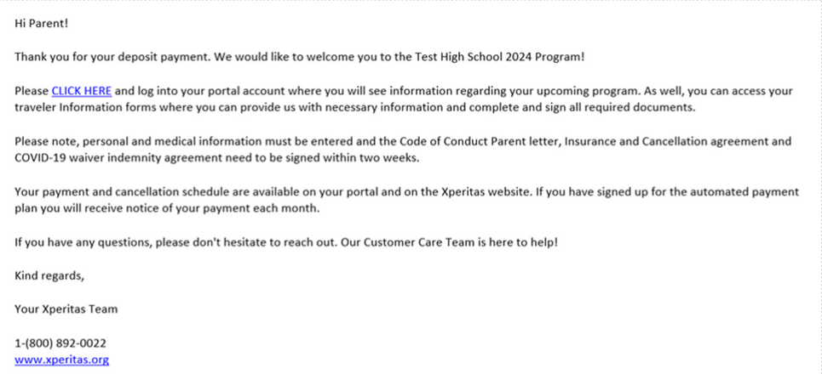
DEPOSIT
Next Steps
Participants must pay a $500 deposit to be enrolled.
SET UP PORTAL
Participants must set up their portal and look out for an email confirmation.
COMPLETE FORMS
Fill out the forms in the portal, particularly the
Health Information section.
NEWSLETTERS
Pay attention to the newsletters that contain important reminders and deadlines! If you unsubscribe from any Xperitas emails, we cannot add you back.
GET PASSPORT
Processing times may be long. Passports should be valid at least 6 months past program return date

Slide 24
Siguientes Pasos
DEPÓSITO
Depósito de $500
PORTAL
Los participantes deben crear un cuenta en el portal de Xperitas y buscar la confirmación por correo electrónico.
.
COMPLETAR LAS FORMAS
Llena las formas en el portal, particularmente la sección C de la información de salud
BOLETINES
Ver los boletines para mas información.

Slide 25

How To Contact Us
Enrollment, Payment, Portal Login
Registration@Xperitas.org
Program Details
Lucia@Xperitas.org
Financial Aid and Scholarships
Leslie@Xperitas.org
www.Xperitas.org

